Slide 1
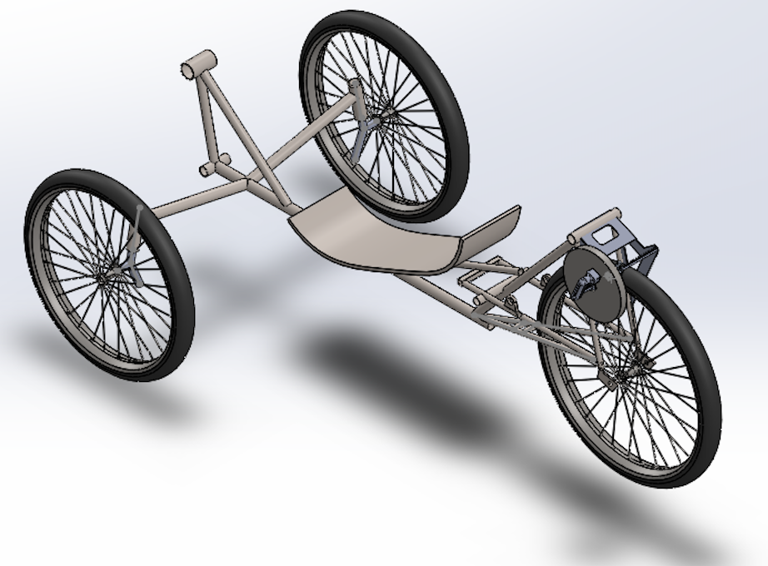
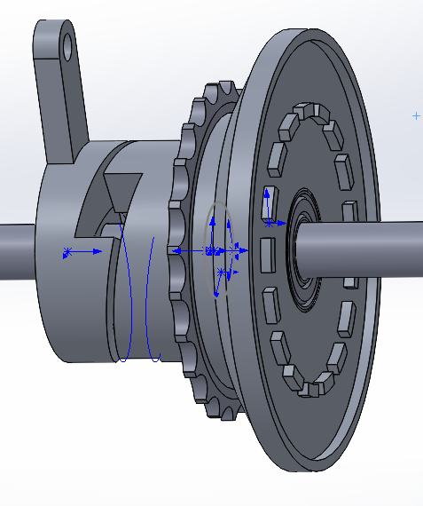
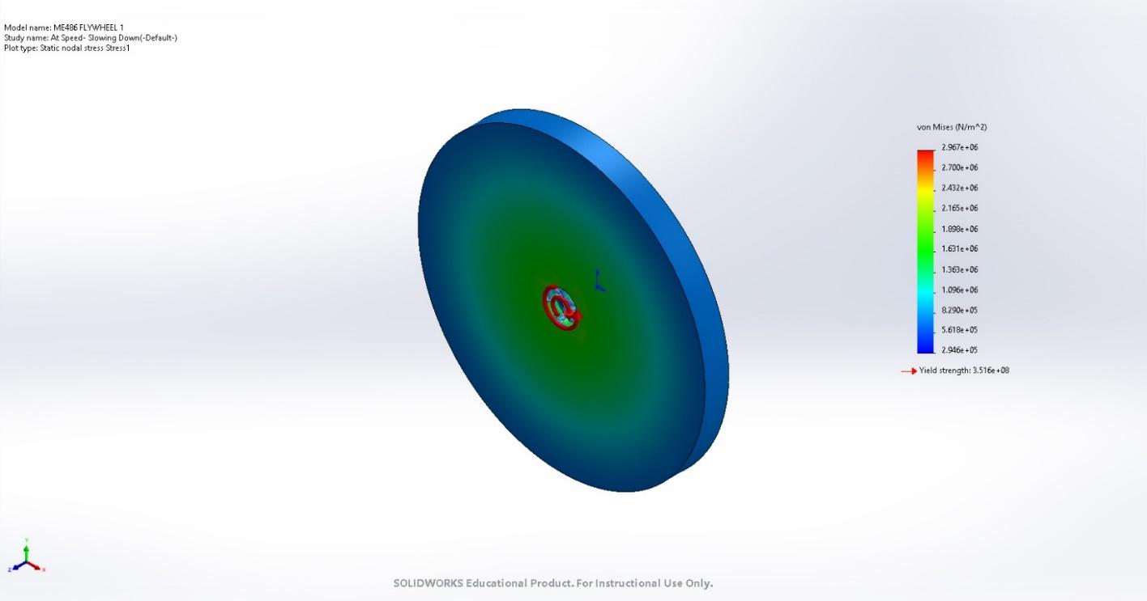
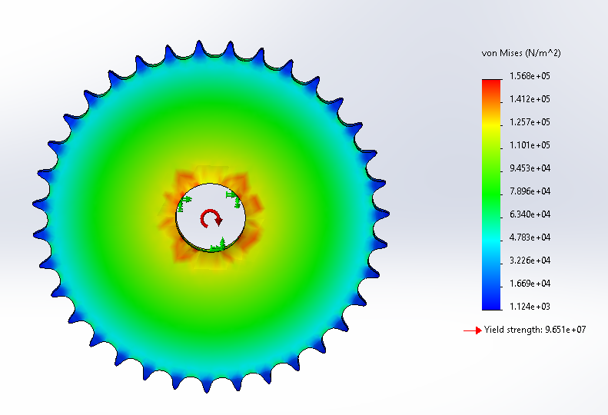
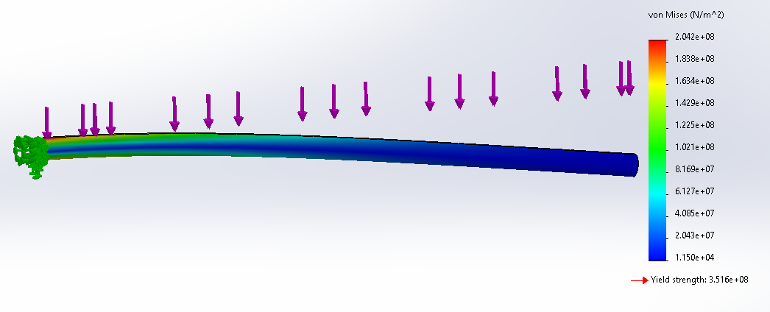
Methods
Human-Powered Vehicle - Propulsion
Abdulh Alsabaie, Yen Clutter, Daniel Quezada, Connor Tolman, Yujie Zhang
Mechanical Engineering, Northern Arizona University, Flagstaff, AZ 86011
Abstract
Final Model
Conclusion
Human-powered vehicles (HPV) are a means of providing efficient transportation on land, often using drive trains similar to bicycles. Our goal is to create non-traditional propulsion system for existing human-powered vehicles. As seen in figures 1 & 2, this system will be comprised of a clutch and flywheel assembly. With this, the vehicle will have the capability to use regenerative braking, and retain kinetic energy for later use. Using finite element analysis (FEA) the team was able to determine safe loading boundaries of the components of the vehicle according to the input forces of the system. After testing the improved HPV the team determined that the propulsion system has met the engineering requirements set forth, and is a viable option for future HPVC teams.
CAD
Using the clutch assembly pictured, energy will be transferred from the rear wheel to the flywheel.
The flywheel should be able to store roughly 600 J of energy. This satisfies the engineering and customer requirements of stored energy.
Based on clutch and flywheel calculations, the energy storage system will be about 15% efficient.
The resulting 120 J output will allow for the operator to get the vehicle moving under power gathered prior
An LCD screen and sensor system was designed, and displays vehicle speed and energy stored, and have speed safety warnings built in. These metrics displayed will serve as indicators for the user to store energy, or employ stored energy.
Figure 1: Full CAD Model
Figure 2: Clutch System
FEA Analysis/Results
In the centrifugal analysis it was found that at the conditions at which the HPV will be operating, the flywheel is safe to operate and does not approach maximum strength levels for steel.
Testing
Requirements
Test | ER Fulfilled | Description | Goal | Result
Energy Storage Efficiency | 1,2 | Tests the efficiency of the clutch system by gathering energy data from before and after engagement of the clutch. | 600 J Stored 15% Efficient | Calculations 984 J 17.4%
Software/Sensor Check | 3,4,5 | Ensures that sensors are working properly and outputting correct data. Checked against data collected with a tachometer. | Metrics Displayed Correctly | Yes
Clutch Wear | N/A | Checks wear of the clutch plate by measuring it before and after testing. Ensures that the plate won't wear too much. | Max wear of 0.01”/hr of engagement | < 0.001”
Customer Requirements:
1 - Safe to Operate
2 - Achieve Max Usable Energy Storage
3 - Display Bike Speed
4 - Display Efficiency
5 - Low Budget
Engineering Requirements: Our Target:
1 - Regenerative Braking Efficiency 15% efficient
2 - Optimal Energy Storage 600 J
3 - Max Speed 20 mph
4 - Budget Limit $1500
5 - Develop Threshold of Usable Energy 200 J
In addition to propulsion system requirements we were tasked with designing a system to capture and display HPV metrics such as speed, flywheel energy storage, and flywheel efficiency. We decided to use an Arduino Mega board, a hall effect sensor, powerful N52 magnets, a 5V battery, and a small LCD display for this system.
Figure 3: Flywheel Centrifugal Analysis
The sprockets involved in the energy storage system were also found to be able withstand both the centrifugal and tangential forces applied to them by the chain.
References
[1] R. G. Budynas, J. K. Nisbett, K. Tangchaichit, and J. E. Shigley, Shigley's Mechanical
Engineering Design. New York, NY: McGraw-Hill, 2019.
Figure 4: Sprocket Stress Analysis
Through FEA analysis, the shaft was found to withstand up to 200 N of force, or more. This is more than sufficient for the system that it will support.
Acknowledgements
Dr. David Willy has stepped in as our advisor and provided a great deal of diction to the team.
Figure 5: Main Shaft Stress Analysis

